Slide 1
Joint Design
ME 313: Mechanical Design
Week 7

Slide 2
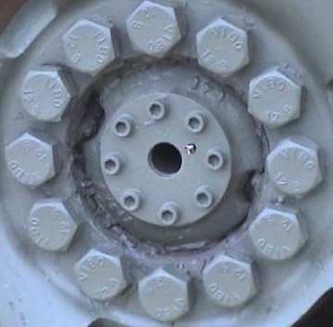
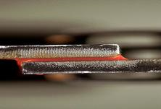
Joints
Use to join two or more components together
Transfer force/displacement between components

Slide 3
Types of Joints
Nonpermanent joints
Bolted joints
Permanent Joints
Welded joints
Adhesive joints

Slide 4
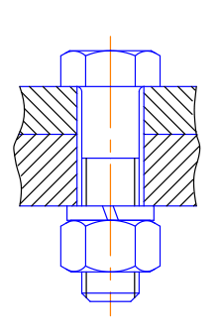
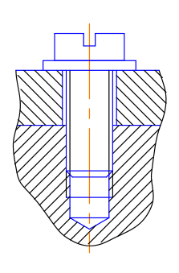
Bolted Joints
Use tension in screws to hold components together
Usually made up of
Screw (or bolt)
Nut
Two or more workpieces

Slide 5
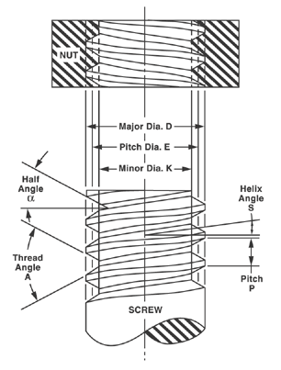
Screw Thread Geometry
Major diameter (D)
Largest diameter
Minor diameter (d)
Smallest diameter
Pitch diameter
Diameter where width of thread and of space are equal
Pitch
Distance between two adjacent threads

Slide 6
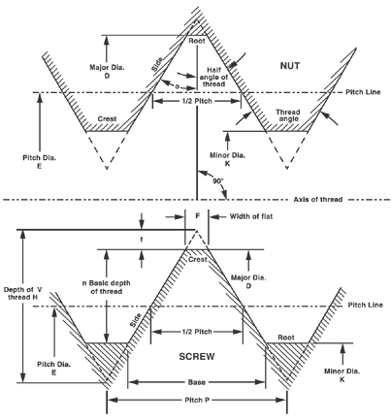
Pitch Diameter Illustration

Slide 7
Screw Thread System
Unified Screw Threads Series
UNC – coarse threads
UNF – fine threads
Constant Pitch Series
Metric Screw Threads Series

Slide 8
Unified Threads Series
Coarse threads
For fast assembly and disassembly
For low strength materials: mild steel, copper, aluminum
Fine threads
For short thread engagement (thin component)
For high strength materials

Slide 9
UNC-UNF Screw Geometries
UNC Size | Major Dia | Threads Per Inch
# | inch | tpi
#1 | 0.073 | 64
#2 | 0.086 | 56
#3 | 0.099 | 48
#4 | 0.112 | 40
#5 | 0.125 | 40
#6 | 0.138 | 32
#8 | 0.164 | 32
#10 | 0.19 | 24
#12 | 0.216 | 24
¼ | 0.25 | 20
5/16 | 0.3125 | 18
3/8 | 0.375 | 16
7/16 | 0.4375 | 14
½ | 0.5 | 13
9/16 | 0.5625 | 12
5/8 | 0.625 | 11
¾ | 0.75 | 10
7/8 | 0.875 | 9
1 | 1 | 8
UNF Size | Major Dia | Threads Per Inch
# | inch | tpi
#0 | 0.06 | 80
#1 | 0.073 | 72
#2 | 0.086 | 64
#3 | 0.099 | 56
#4 | 0.112 | 48
#5 | 0.125 | 44
#6 | 0.138 | 40
#8 | 0.164 | 36
#10 | 0.19 | 32
#12 | 0.216 | 28
1/4 | 0.25 | 28
5/16 | 0.3125 | 24
3/8 | 0.375 | 24
7/16 | 0.4375 | 20
1/2 | 0.5 | 20
9/16 | 0.5625 | 18
5/8 | 0.625 | 18
3/4 | 0.75 | 16
7/8 | 0.875 | 14
1 | 1 | 12

Slide 10
Constant Pitch and Metric Series
Constant Pitch Series
Fixed number of threads per inch
Have 4, 6, 8, 12, 16, 20, 28, 32 threads per inch
Metric Series
Major diameters in metric unit

Slide 11
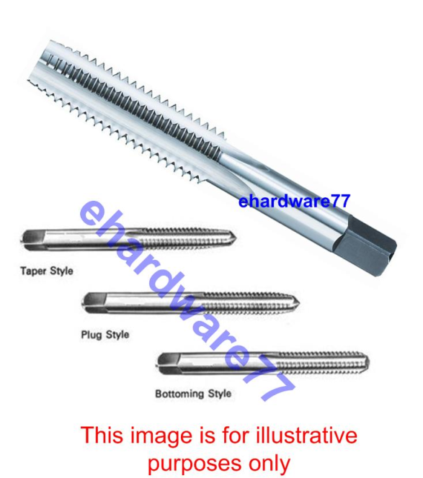
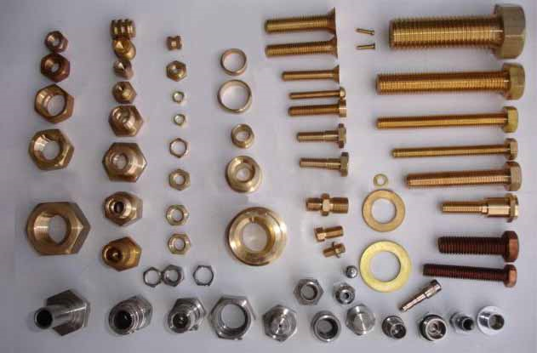
Pairing with Screws
Screws are paired with nuts or threaded components of the same diameter and thread count
Thread components are made by first drill a hole and use a thread maker to cut threads

Slide 12
Bolted Joint Stiffness
Twisting the screw stretches it, producing a clamping force—bolt preload
Stiffness composed of two part
Unthreaded portion
Threaded portion
Total stiffness is the spring connected in series

Slide 13
Fastener Stiffness (cont)
Stiffness of bolt in clamped area is
A_{t} = minor-diameter area of bolt
L_{t} = length of threaded portion of the grip
A_{d} = major-diameter area of bolt
L_{d} = length of unthreaded portion in grip

Slide 14
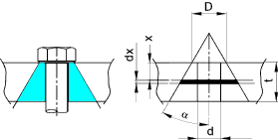
Member Stiffness
D is diameter of washer
d is the minor diameter
t is the grip length (thickness)
α is the pressure cone angle
Notes:
Pressure cone angle can be assumed to be 30 degree in most case, unless specified otherwise
If washer diameter is not specified, use screw head diameter

Slide 15
External Tensile Load on Bolted Joints
If the bolt has been preloaded to F_{i} and there is external load P
The load will cause the joint to stretch
Notes:
Load in member and bolt depends on relative stiffness

Slide 16
Relating Bolt Torque to Bolt Tension
K is called a torque coefficient
F_{i} is the tension in the bolt
d is the minor diameter
Bolt Condition | K
Nonplated, black finish | 0.30
Zinc-plated | 0.20
Lubricated | 0.18
Cadmium-plated | 0.16

Slide 17
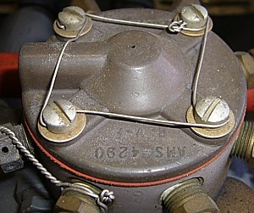
Gasketed Joint
Use to keep pressure/fluid inside

Slide 18
Examples

Slide 19
Questions

Slide 20
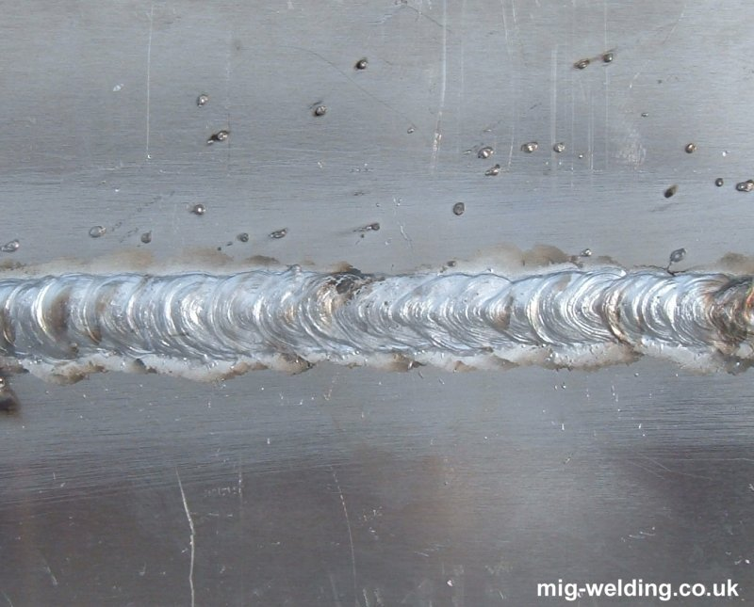
Permanent Joints
Welded joints
Adhesive joints

Slide 21
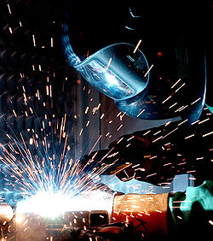
Welding
Joining workpieces by partial melting, adding filler, and letting the joints cool

Slide 22
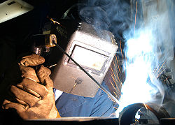
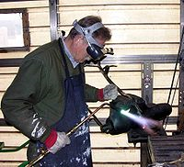
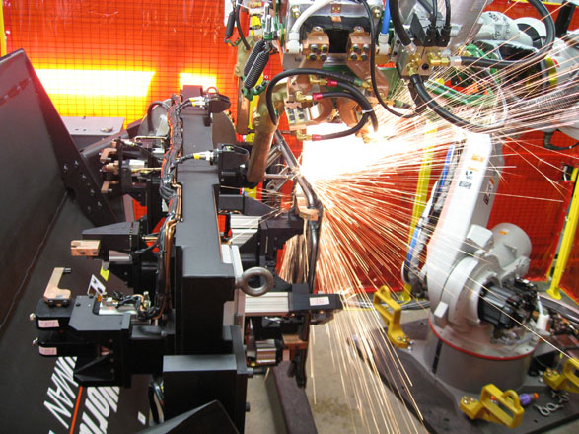
Types of Welding Processes
Arc Welding
heat from electrical arc
Gas Welding
Heat from gas combustion
Resistance Welding
Heat from component resistance

Slide 23
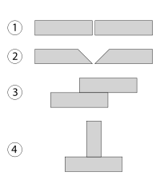
Geometry of Welded Joints
Square butt joint
V-butt joint
Lap joint
T-joint

Slide 24
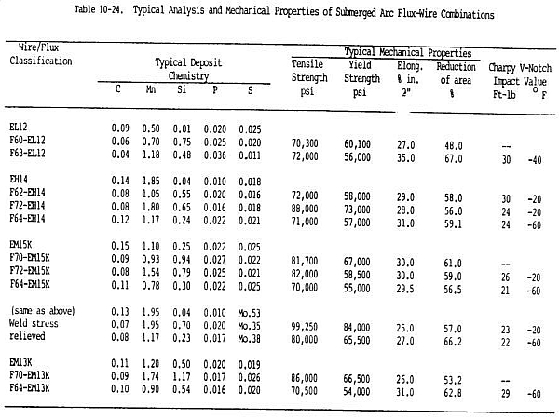
Weld Electrode Properties

Slide 25
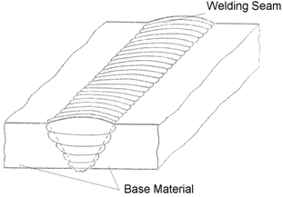
Weld Stress Analysis
F
For butt welds
l
l
F
F
h
h
F
F

Slide 26
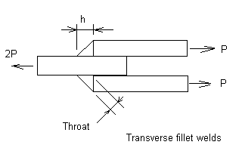
Fillet Welds Under Axial Loads
h
h
2F
h
F
F
Normal and shear stresses depend on orientation of consideration
Stresses listed not considering stress concentration

Slide 27
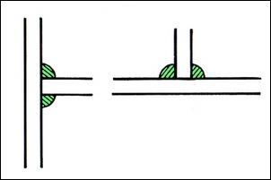
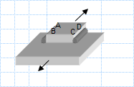
Stress Concentration in Welded Joints
Type of Weld | Stress Concentration Factor
Reinforced butt weld | 1.2
Toe of transverse fillet weld | 1.5
End of parallel fillet weld | 2.7
T-butt joint with sharp corners | 2.0

Slide 28
Design Parameters
l
h
Pattern of weld (distribution, b, d)
Type of weld (depends on material and thickness)
Length of weld l
Leg size h

Slide 29
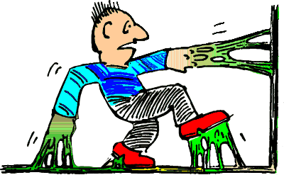
Adhesive Joints
The use of ‘glue’ to join parts
Most effective use is to prevent shearing

Slide 30
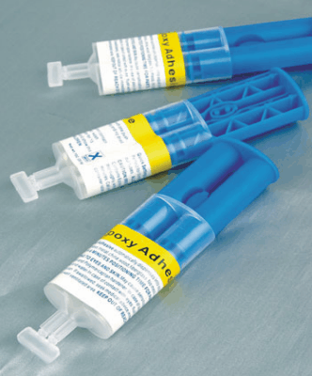
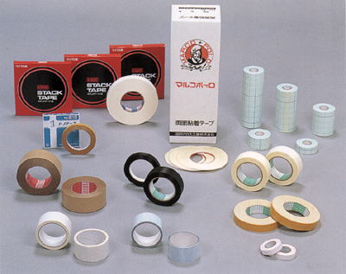
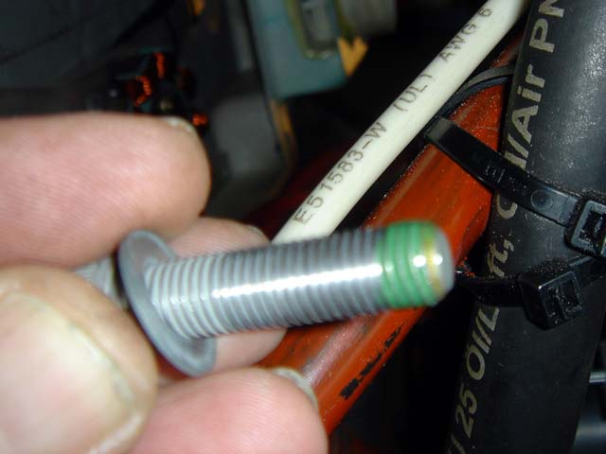
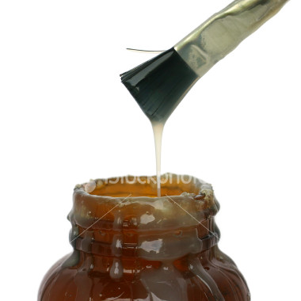
Types of Adhesives
Structural adhesives
Can carry significant stresses
Epoxies
Nonstructural adhesives
Pressure sensitive
Duct tapes, scotch tapes, labels
Contact sensitive
Rubber cement
Anaerobic
Thread locking glue

Slide 31
Mechanical Performance of Typical Adhesives
Adhesive Type | Lap-Shear Strength (MPa) | Peel Strength per unit width, kN/m
Pressure sensitive | 0.01-0.07 | 0.18-0.88
Starch-based | 0.07-0.7 | 0.18-0.88
Rubber-based | 0.35-3.5 | 1.8-7
Urethane | 6.9-17.2 | 1.8-8.8
Phenolic | 13.8-27.6 | 3.6-7
Epoxy | 10.3-27.6 | 0.35-1.8
Rubber-modified epoxy | 20.7-41.4 | 4.4-14

Slide 32


Basic Adhesive Joint Design
Good design allows adhesive to carry load in shear, not tension
F
F
F
F

Slide 33
Shear Stress Distribution in Adhesive Lap Joint
P/2
y
P
x
P/2
h
l

Slide 34
Residual Stresses in Adhesive Joint
When joint constructing temperature is different from operating temperature
Mismatch in coefficient of thermal expansions result in residual stress

Slide 35
Designing with Adhesive
Be aware of environmental effect
Degradation due to heat, light, or corrosion
Design for easy inspection
Harder to detect degraded bond than missing bolts
Allow sufficient bond area
Debonding should be expected. Allow some debonding before joint breakage
Creep is an issue
Temperature + load + adhesive = creep. Choose the right adhesive for the operating temperature

Slide 36
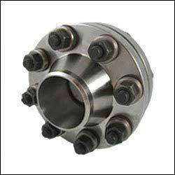
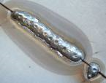
Comparison between Joint Types
Properties | Bolted Joints | Welded Joints | Adhesive Joints
Weight | High | Small | Small
Joint strength | High | High | Low
Part count | High | Low | Low
Assembly time | Low | High | Low
Labor Skill Required | Low | High | Low
Cost | High | High | Low

Slide 37
Questions?

